Slide 1


CHESHIRE VETERANS FOOTBALL LEAGUE
2026 AGM
Monday 6th July
In person at The Cottons Hotel and by Zoom
CHESHIRE VETERANS FOOTBALL LEAGUE

Slide 2
WELCOME
The League extends a welcome to:
  All Club and Team representatives present here at Cottons Hotel
  Plus Club and Team representatives who are on Zoom
  Members of the League Management Committee
  The League’s Divisional Administrators
  And finally, to representatives of those teams who will be joining the League from next season
CHESHIRE VETERANS FOOTBALL LEAGUE

Slide 3
AGENDA
Minutes of the 2025 AGM (and 2025 SGM)
Annual Report / Balance Sheet / Statement of Accounts
Election of Clubs to fill vacancies
Constitution of the Competition for the 2026/27 season
Election of Competition Officers and Management Committee members
Appointment of auditors/verifiers
Alteration of Rules
Date for the beginning of the Playing Season and kick off times
Date for the end of the Playing Season
Any Other Business
Questions
CHESHIRE VETERANS FOOTBALL LEAGUE

Slide 4
Does anyone object to these Minutes
being formally approved?
CHESHIRE VETERANS FOOTBALL LEAGUE

Slide 5
AGENDA
Minutes of the 2025 AGM (and 2025 SGM)
Annual Report / Balance Sheet / Statement of Accounts
Election of Clubs to fill vacancies
Constitution of the Competition for the 2026/27 season
Election of Competition Officers and Management Committee members
Appointment of auditors/verifiers
Alteration of Rules
Date for the beginning of the Playing Season and kick off times
Date for the end of the Playing Season
Any Other Business
Questions
CHESHIRE VETERANS FOOTBALL LEAGUE

Slide 6
Annual report:
The 2025-26 Playing Season
CHESHIRE VETERANS FOOTBALL LEAGUE

Slide 7
OVER 35s HIGHLIGHTS
Congratulations to League Champions
WYTHENSHAWE FC
… who win their first League Championship in their 10th season with the League
Northenden Victoria (5 yrs) Baguley Athletic (2 yrs) Wythenshawe B (1 yr) Wythenshawe FC (2 yrs)
CHESHIRE VETERANS FOOTBALL LEAGUE

Slide 8
OVER 35s HIGHLIGHTS
Congratulations to our other 7 Divisional Winners
  D1: East Manchester
  D2: Stockport Georgians
  D3: Blackbrook
  D4: Moore United
  D5: Middlewich Town
  D6: Pennington FC
  D7: Blackbrook B
CHESHIRE VETERANS FOOTBALL LEAGUE

Slide 9
OVER 45s HIGHLIGHTS
Congratulations to League Champions
HINDSFORD
… who win their second League Championship in three years
CHESHIRE VETERANS FOOTBALL LEAGUE

Slide 10
OVER 45s HIGHLIGHTS
Congratulations to our other 2 Divisional Winners
  D1: Old Alts
  D2: Chelford
CHESHIRE VETERANS FOOTBALL LEAGUE

Slide 11
FIXTURES
Season | Matches | Number Not Played | %age Not Played
2025-26 | 762 | 94 | 12%
2024-25 | 644 | 75 | 12%
2023-24 | 622 | 85 | 14%
2022-23 | 560 | 80 | 14%
CHESHIRE VETERANS FOOTBALL LEAGUE

Slide 12
FIXTURES – CONCESSIONS / VOIDED
DIVISION | Conceded | vs 24-25 season
Premier | 11 | +7
Division 1 | 3 | -1
Division 2 | 22 | +8
Division 3 | 10 | +2
Division 4 | 13 | +8
Division 5 | 6 | -1
Division 6 | 12 | +8
Division 7 | 0 | -2
TOTAL | 77 | +27
DIVISION | Conceded | vs 24-25 season
O45 Premier | 9 | +5
O45 Division 1 | 0 | -4
O45 Division 2 | 3 | -3
Cup Competitions | 10 | -1
TOTAL | 22 | -3
CHESHIRE VETERANS FOOTBALL LEAGUE

Slide 13
FIXTURES: TEAMS DROPPING OUT
Dropouts were much less significant – which was a very welcome change from the past few seasons
Just 1 team that started the season failed to complete it!
CHESHIRE VETERANS FOOTBALL LEAGUE

Slide 14
CUP WINNERS
CUP | WINNER | SCORE | RUNNER-UP | VENUE
President’s | Radcliffe Old Boys | 2 - 0 | AFC Monton | Ashton United
Chairman’s | Stockport Georgians | 2 - 0 | Westbury Sports Club | Ashton United
Treasurer’s | Shrewsbury Arms | 2 - 1 | Pennington | Rylands
Over 45s | Nicosia | 3 - 2 | Denton Town | Rylands
Congratulations and commiserations to the Cup Finalists
CHESHIRE VETERANS FOOTBALL LEAGUE

Slide 15
CUP FINALS DAY
The League thanks Rylands and Ashton United
for hosting the finals
The League also thanks our Match Officials both on the day and indeed for their efforts across the whole season.
Thanks also go to the League Referees Officer – David Ng – for his continued efforts over the past 12 months.
CHESHIRE VETERANS FOOTBALL LEAGUE

Slide 16
PREMIER CUP WINNERS
There was also a Premier Cup organised just for most of the teams in the O35s Premier Division
The final also took place at Rylands where, unfortunately, the
Match was abandoned following a serious injury to one of the Wythenshawe FC players (Stephen Ireland).
The 3-0 scoreline to Wythenshawe was allowed to stand as the final score.
CHESHIRE VETERANS FOOTBALL LEAGUE

Slide 17
COUNTY CUP WINNERS
Clubs from the League took part in 4 different County Cups
CHESHIRE Stockport Georgians defeated Vauxhall Motors 6-1
LANCASHIRE Wythenshawe defeated Vickerstown 8-2
LIVERPOOL Collegiate were due to play Bootle (result unknown)
MANCHESTER Wythenshawe defeated East Manchester 9-2
CHESHIRE VETERANS FOOTBALL LEAGUE

Slide 18
CUP COMPETITIONS
OVER 35s
  PRESIDENT’S CUP Premier & Division 1
  CHAIRMAN’S CUP Divisions 2, 3, 4
  TREASURER’S CUP Divisions 5, 6, 7, 8
OVER 45s Premier, Division 1 & 2
THERE MAY BE SOME CHANGES TO THESE ARRANGEMENTS
  This depends on the final size of the League
CHESHIRE VETERANS FOOTBALL LEAGUE

Slide 19
Cheshire Veterans Football League vs England Vets
A special mention to those who organised and/or played in this 22nd March fixture
3-3 at half time became 7-3 to the League representative team!
Particular mentions to Vauxhall Motors’ John Cotton for leading on the organisation of this and (perhaps inevitably) to Dave Fashou for scoring a hat-trick!
CHESHIRE VETERANS FOOTBALL LEAGUE

Slide 20
Balance Sheet /
Statement of Accounts
CHESHIRE VETERANS FOOTBALL LEAGUE

Slide 21
Finance
2025/26
CHESHIRE VETERANS FOOTBALL LEAGUE
AGM 2026
Monday 06th Jul 2026 – The Verandah Suite, Cottons Hotel Knutsford

Slide 22

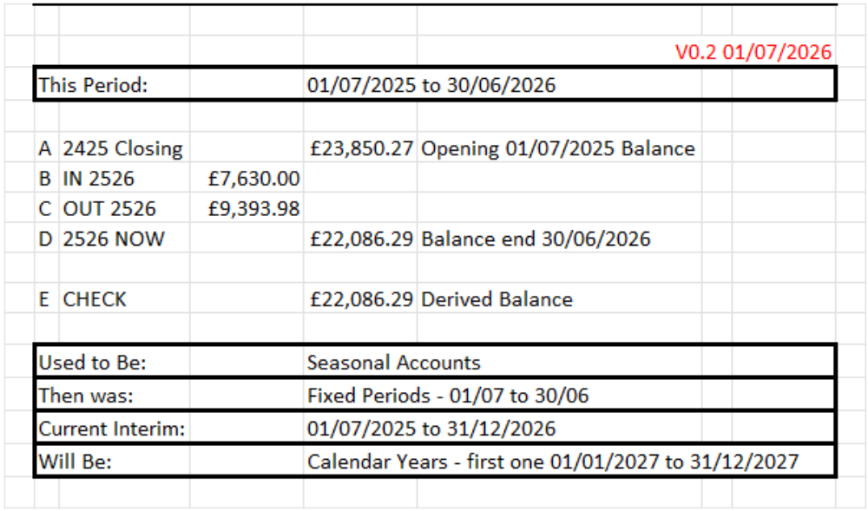


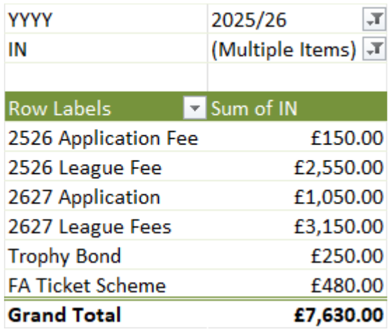
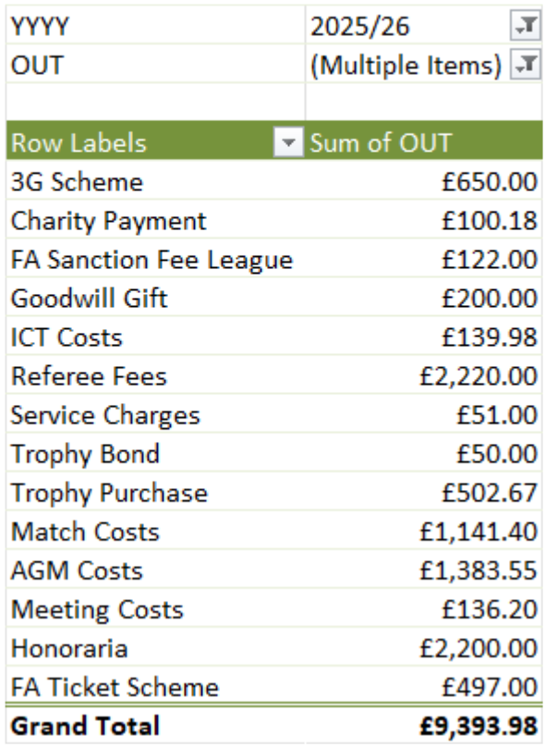

Slide 23
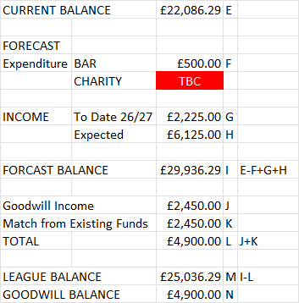
Assumes:
The league will have 98 teams
Numbers here as at noon Sun 05 Jul 2026
Goodwill Income:
3G Scheme
‘Out of Pocket’ expenses for clubs
Representative games
Danish O50/O55 visitors
League Funds:
O55 launch
NB: The 2026/27 goodwill payments will be set in May 2027 as required

Slide 24
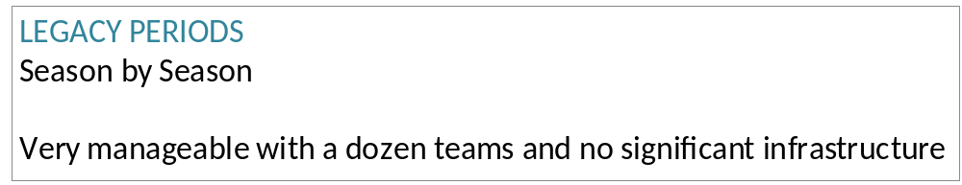

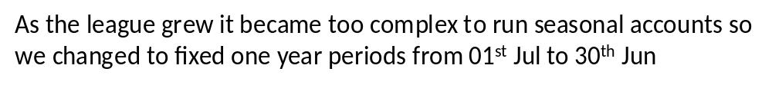

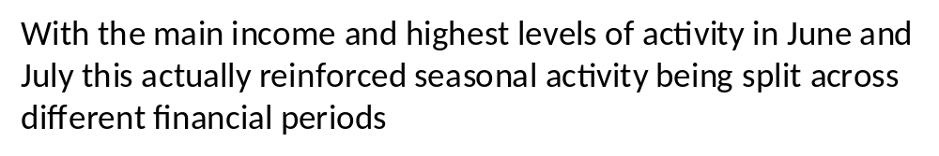
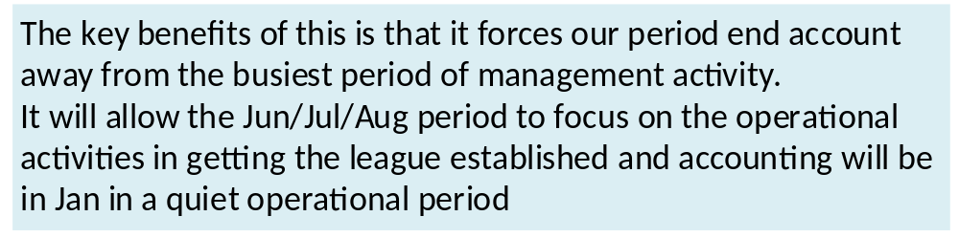
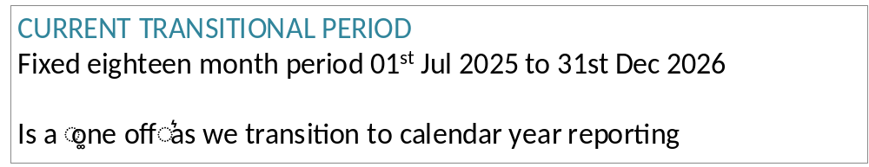


Slide 25
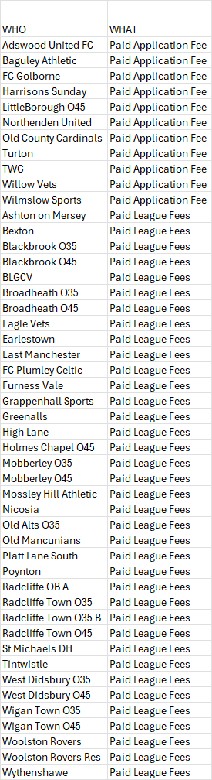
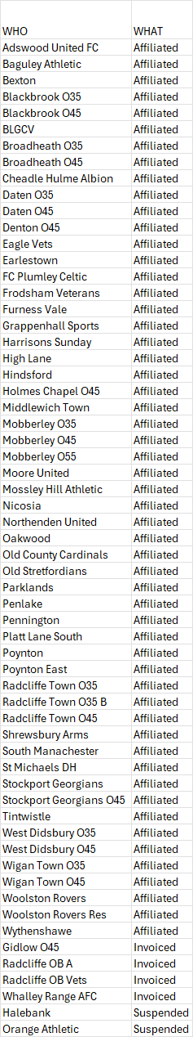
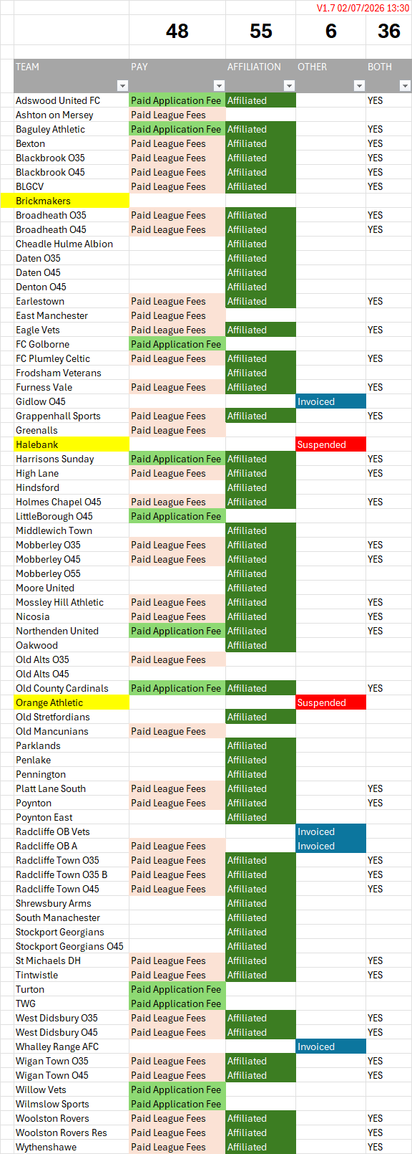
As at 12 noon Sun 05 Jul add
Fees: Alderman
Aff: Ashton on Mersey

Slide 26
AGENDA
Minutes of the 2025 AGM (and 2025 SGM)
Annual Report / Balance Sheet / Statement of Accounts
Election of Clubs to fill vacancies
Constitution of the Competition for the 2026/27 season
Election of Competition Officers and Management Committee members
Appointment of auditors/verifiers
Alteration of Rules
Date for the beginning of the Playing Season and kick off times
Date for the end of the Playing Season
Any Other Business
Questions
CHESHIRE VETERANS FOOTBALL LEAGUE

Slide 27
NEW TEAMS
Over 35s
1. Adswood United South Manchester Paid Affiliated
2. Alt Park FC Harrisons Liverpool Paid Affiliated
3. Baguley Athletic South Manchester Paid Affiliated Welcome back!!
4. Northenden United South Manchester Paid Affiliated
5. Old County Cardinals South Manchester Paid Affiliated
6. Poynton East Cheshire East Paid Affiliating
7. Radcliffe Rangers North Manchester xxx xxx
8. Timperley FC South Manchester Paid xxx
9. Turton Vets South Lancashire Paid xxx
10. Tytherington Cheshire East Paid xxx
11. Whalley Range AFC South Manchester Paid Affiliating
12. Wilmslow Sports Club Cheshire East Paid xxx
13. Woodford Vulcan Stockport Paid xxx
CHESHIRE VETERANS FOOTBALL LEAGUE

Slide 28
NEW TEAMS
Over 35s
There is a little uncertainty about 3 other teams:
  Old Boltonians North Manchester
  ?? ?? location
CHESHIRE VETERANS FOOTBALL LEAGUE

Slide 29
NEW TEAMS
Over 45s
FC Golborne South Lancashire Paid xxx
Littleborough North East Manchester Paid xxx
CHESHIRE VETERANS FOOTBALL LEAGUE

Slide 30
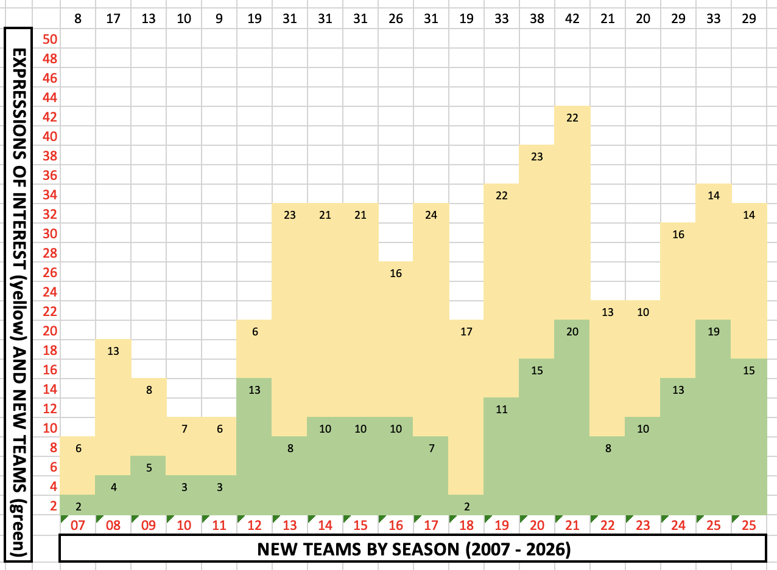
NEW TEAMS
CHESHIRE VETERANS FOOTBALL LEAGUE

Slide 31
AGENDA
Minutes of the 2025 AGM (and 2025 SGM)
Annual Report / Balance Sheet / Statement of Accounts
Election of Clubs to fill vacancies
Constitution of the Competition for the 2026/27 season
Election of Competition Officers and Management Committee members
Appointment of auditors/verifiers
Alteration of Rules
Date for the beginning of the Playing Season and kick off times
Date for the end of the Playing Season
Any Other Business
Questions
CHESHIRE VETERANS FOOTBALL LEAGUE

Slide 32
2026/27 Season
Over 35s
67 teams finished the season
- 8 (ish) leaving
+13 (ish) joining
= 72 teams next year
At 8 per Division, that is 9 Divisions
(if more teams the lower Divisions will have 9)
CHESHIRE VETERANS FOOTBALL LEAGUE

Slide 33
2026/27 Season
Over 45s
24 teams finished the season
- 0 (ish) leaving
+ 2 (ish) joining
= 26 teams next year
Likely to have 1 Division of 8 and 2 of 9
CHESHIRE VETERANS FOOTBALL LEAGUE

Slide 34
AGENDA
Minutes of the 2025 AGM (and 2025 SGM)
Annual Report / Balance Sheet / Statement of Accounts
Election of Clubs to fill vacancies
Constitution of the Competition for the 2026/27 season
Election of Competition Officers and Management Committee members
Appointment of auditors/verifiers
Alteration of Rules
Date for the beginning of the Playing Season and kick off times
Date for the end of the Playing Season
Any Other Business
Questions
CHESHIRE VETERANS FOOTBALL LEAGUE

Slide 35
MANAGING THE LEAGUE: MANAGEMENT COMMITTEE
ROLE |  | ROLE
President | Mel Hood | Referees Secretary | David Ng
Chairman | Howell Davies | Fixtures Secretary | Glyn McGovern
Secretary | Ian Gould | Web Site / Social Media | Glyn McGovern
Treasurer | Steve Power | Registration Secretary | Sheila Davies
 |  | Trophy Secretary | Ian Gould
No changes are proposed
CHESHIRE VETERANS FOOTBALL LEAGUE

Slide 36
MANAGING THE LEAGUE: 2026-27 DIVISIONAL ADMINISTRATORS
DIVISION |  | DIVISION
P | Dave Morgan | O45P | Glyn McGovern
D1 | Ian Gould | O451 | Tommy Cassidy
D2 | Nick Wooldridge | O452 | Steve Jackson (Bexton)
D3 | Glyn McGovern
D4 | Ian Gould | Cups | Glyn McGovern
D5 | Glyn McGovern
D6 | Steve Jackson (Rockets)
D7 | Simon Kaines
CHESHIRE VETERANS FOOTBALL LEAGUE

Slide 37
MANAGING THE LEAGUE: 2026-27 DIVISIONAL ADMINISTRATORS
By the end of the 2025-26 season, Ian Gould was…
  League Secretary Trophy Secretary
  Div Admin for the Premier Division Div Admin for Division 1
  Div Admin for Division 3 Div Admin for Division 4
  Div Admin for Division 5
He was close to resigning towards the end of the season
For the League to continue to thrive, we need more people to become Divisional Admins (and to complete the season before resigning)
Div Admins do not attend any meetings!!
CHESHIRE VETERANS FOOTBALL LEAGUE

Slide 38
AGENDA
Minutes of the 2025 AGM (and 2025 SGM)
Annual Report / Balance Sheet / Statement of Accounts
Election of Clubs to fill vacancies
Constitution of the Competition for the 2026/27 season
Election of Competition Officers and Management Committee members
Appointment of auditors/verifiers
Alteration of Rules
Date for the beginning of the Playing Season and kick off times
Date for the end of the Playing Season
Any Other Business
Questions
CHESHIRE VETERANS FOOTBALL LEAGUE

Slide 39
6. Appointment of auditors/verifiers
There is no proactive plan to appoint anyone in this role
If, however, someone is willing to undertake a role in this area – please let Steve Power know.
CHESHIRE VETERANS FOOTBALL LEAGUE

Slide 40
AGENDA
Minutes of the 2025 AGM (and 2025 SGM)
Annual Report / Balance Sheet / Statement of Accounts
Election of Clubs to fill vacancies
Constitution of the Competition for the 2026/27 season
Election of Competition Officers and Management Committee members
Appointment of auditors/verifiers
Alteration of Rules
Date for the beginning of the Playing Season and kick off times
Date for the end of the Playing Season
Any Other Business
Questions
CHESHIRE VETERANS FOOTBALL LEAGUE

Slide 41
Rule Changes (1)
There are some minor changes to the Standard Code of Rules (in the introduction plus sections 2.H 4.A 6.N 18.B 18.F2 18.G4 18.M 18.Q 20.F and 20.I
There are a few other changes that need mentioning…
CHESHIRE VETERANS FOOTBALL LEAGUE

Slide 42
Rule Changes (2)
SECTION 4 (ENTRY FEE, SUBSCRIPTION, DEPOSIT
4.B The annual subscription shall be payable, in accordance with the Fees Tariff for each TEAM It shall be payable by a date set by the Management Committee.
This brings the rules into line with what we do
CHESHIRE VETERANS FOOTBALL LEAGUE

Slide 43
Rule Changes (3)
SECTION 8 (ANNUAL GENERAL MEETING)
Clubs currently in membership of the Competition shall be entitled to vote on items 1 to 3 above.
Those clubs set to be accepted as Clubs in accordance with item 3 above shall be entitled to attend the AGM, but cannot vote on items 1-3 above.
All Clubs (i.e. those Clubs currently in membership of the Competition and those accepted as Clubs in accordance with item 3) shall be entitled to vote on items 4 to 10 above.
The format of the AGM is now more rigidly laid out – the wording for
new Clubs is “relevant”
CHESHIRE VETERANS FOOTBALL LEAGUE

Slide 44
Rule Changes (4)
SECTION 10 (AGREEMENT TO RULES OF THE COMPETITION)
10.A Membership of the Competition shall constitute an agreement between the Competition and a Club to be bound by and comply with these Rules (including any decision of the Management Committee made pursuant to these Rules
10.B Any change of Chair, Secretary or Directors of the Club must be notified to the parent County Football Association to which the Club is sanctioned and to the Secretary of this Competition. Failure to comply with this Rule will result in a fine in accordance with the Fines
FOR INFORMATION – NO LONGER A FORM TO FILL IN
CHESHIRE VETERANS FOOTBALL LEAGUE

Slide 45
Rule Changes (5)
SECTION 10 (AGREEMENT TO RULES OF THE COMPETITION)
10.A Membership of the Competition shall constitute an agreement between the Competition and a Club to be bound by and comply with these Rules (including any decision of the Management Committee made pursuant to these Rules
10.B Any change of Chair, Secretary or Directors of the Club must be notified to the parent County Football Association to which the Club is sanctioned and to the Secretary of this Competition. Failure to comply with this Rule will result in a fine in accordance with the Fines
FOR INFORMATION – NO LONGER A FORM TO FILL IN
CHESHIRE VETERANS FOOTBALL LEAGUE

Slide 46
Rule Changes (6)
SECTION 18 (QUALIFICATION OF PLAYERS)
A Player may not be registered for a Club nor transferred to another Club in the Competition after 31st March except by special permission of the Management Committee
FOR INFORMATION – Sheila will only approve Player Registration requests (including transfers) between April 1st and May 31st if…
    A new player has just reached the age of 35
    The player being registered is a Goalkeeper (through injury)
    If instructed to do so by Ian Gould
CHESHIRE VETERANS FOOTBALL LEAGUE

Slide 47
Rule Changes (7)
SECTION 23 (MATCH OFFICIALS)
OUR RULE CURRENTLY SAYS
Match Officials will be paid their fees SHARED EQUALLY BY THE HOME AND THE AWAY CLUB before the Competition Match. Failure to comply with this Rule will result in a fine in accordance with the Fines Tariff.
SCOR SAYS
Match Officials will be paid their fees and/or expenses by the home Club before/immediately after the Competition Match. Failure to comply with this Rule will result in a fine in accordance with the Fines Tariff.
PROPOSAL IS TO ADOPT THE SCOR RULE
CHESHIRE VETERANS FOOTBALL LEAGUE

Slide 48
AGENDA
Minutes of the 2025 AGM (and 2025 SGM)
Annual Report / Balance Sheet / Statement of Accounts
Election of Clubs to fill vacancies
Constitution of the Competition for the 2026/27 season
Election of Competition Officers and Management Committee members
Appointment of auditors/verifiers
Alteration of Rules
Date for the beginning of the Playing Season and kick off times
Date for the end of the Playing Season
Any Other Business
Questions
CHESHIRE VETERANS FOOTBALL LEAGUE

Slide 49
Timeline & Deadlines
DATE
6th July | Player registration formally opened today (204 players from 13 teams are registered so far)
15th July | Teams must be visible on the Competition Portal by this date (allows fixture setting to start)
15th July | League Fees must be paid by this date
31st Jul | Deadline to submit “Can’t Play” dates … and state if you want a match on 23rd or 30th August
1st Aug | Creation of Divisions on Competition Portal commences
post 1st Aug | We will try to add any teams who fail to meet the deadline but cannot promise anything as fixture setting will be taking place almost immediately
4th Aug | League creation on Full Time commences
9th Aug | Divisions and Fixtures available on Full Time
6th Sep | SEASON START DATE
13th Sep | Deadline for all teams to have at least 16 players registered
31st Mar ’27 | Final date for new Player Registrations (other than age-related)
16th May ‘27 | CUP FINALS DAY
31st May ‘27 | SEASON END DATE
CHESHIRE VETERANS FOOTBALL LEAGUE

Slide 50
TIMELINE
The Club Affiliation window is already open:
  58 teams have already completed their Affiliation
  3 teams are at “invoiced” stage
  32 teams are “unaffiliated”
  11 teams are missing from the portal
Around 60 teams have already paid their Application or League Fees
CHESHIRE VETERANS FOOTBALL LEAGUE

Slide 51
TROPHIES
For the coming season…
All Cups and Shields are to be returned by 1st April 2027
Cups will be handed out on the day of the Final (16th May, 2027)
Shields will be engraved and handed out at the 2027 AGM
CHESHIRE VETERANS FOOTBALL LEAGUE

Slide 52
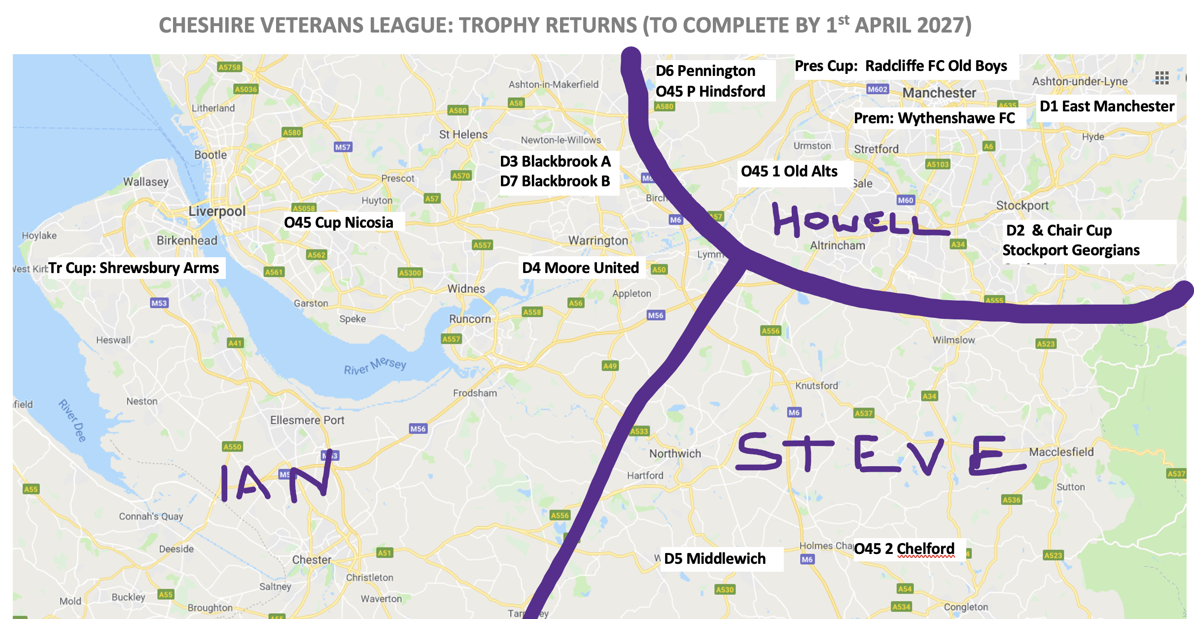
Please make arrangements for the return to the person shown…
CHESHIRE VETERANS FOOTBALL LEAGUE

Slide 53
MATCHDAY
Those that use it fine Matchday makes an organiser’s job much simpler that if it is done manually / via WhatsApp
Try it and see the benefits
Steve Power …. Anything to add?
CHESHIRE VETERANS FOOTBALL LEAGUE

Slide 54
MANAGING THE LEAGUE
This League is managed according
to a few strong principles
CHESHIRE VETERANS FOOTBALL LEAGUE

Slide 55
MANAGING THE LEAGUE
a) LOW GOVERNANCE … examples being:
    Very few meetings
      only the AGM for Clubs
      (not that many) Zoom meetings for the League
    AGM attendance not obligatory
    No “in season” fines
    Unwillingness to condone (really) poor on-field behaviour
    Very limited number of “League diktaks”
CHESHIRE VETERANS FOOTBALL LEAGUE

Slide 56
MANAGING THE LEAGUE
b) LOW ADMINISTRATION … examples are:
    Most of the Low Governance examples result in reduced admin for both Clubs and the League itself
    No formal “application to join” process
    Divisional Admins empowered to administer their Divisions as they see fit
CHESHIRE VETERANS FOOTBALL LEAGUE

Slide 57
MANAGING THE LEAGUE
c) INCLUSIVE … examples are:
A wide area in which the League operates (growing in a minor way most years)
New applicants are taken on face value
CHESHIRE VETERANS FOOTBALL LEAGUE

Slide 58
AGENDA
Minutes of the 2025 AGM (and 2025 SGM)
Annual Report / Balance Sheet / Statement of Accounts
Election of Clubs to fill vacancies
Constitution of the Competition for the 2026/27 season
Election of Competition Officers and Management Committee members
Appointment of auditors/verifiers
Alteration of Rules
Date for the beginning of the Playing Season and kick off times
Date for the end of the Playing Season
Any Other Business
Questions
CHESHIRE VETERANS FOOTBALL LEAGUE

Slide 59
9. Date for the end of the Playing Season
31st May, 2027
CHESHIRE VETERANS FOOTBALL LEAGUE

Slide 60
AGENDA
Minutes of the 2025 AGM (and 2025 SGM)
Annual Report / Balance Sheet / Statement of Accounts
Election of Clubs to fill vacancies
Constitution of the Competition for the 2026/27 season
Election of Competition Officers and Management Committee members
Appointment of auditors/verifiers
Alteration of Rules
Date for the beginning of the Playing Season and kick off times
Date for the end of the Playing Season
Any Other Business
Questions
CHESHIRE VETERANS FOOTBALL LEAGUE

Slide 61
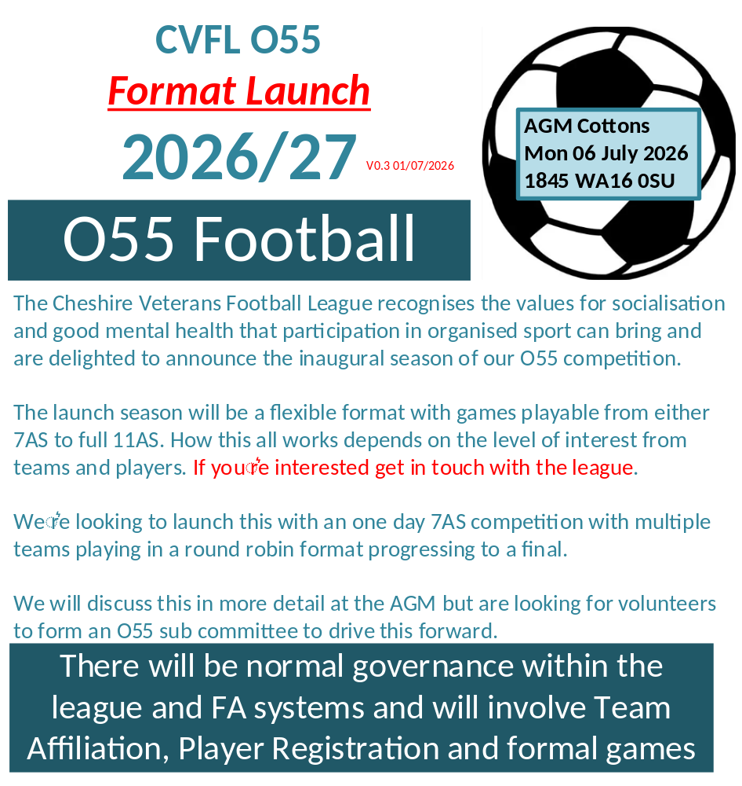

Slide 62


Slide 63
REFEREE SCHEME
The League is happy to provide support to players within the League who wish to train as Referees.
If any of your players is looking to make the switch from playing (or alongside playing), please get them to email our Referees Secretary (David Ng) on daveng888@gmail.com and he will happily share more details!
CHESHIRE VETERANS FOOTBALL LEAGUE

Slide 64
WARRINGTON VETERANS LEAGUE
This has commenced this season and it is likely that there will be some impact on our League over the next few seasons.
We welcome the arrival of more Veterans Leagues (along with Bolton, Tameside and some Leagues in Liverpool)
CHESHIRE VETERANS FOOTBALL LEAGUE

Slide 65
WYTHENSHAWE FC
Wythenshawe FC have certainly added a sparkle to the League! This will continue next season and there is a documentary project planned.
The idea is to follow the team through league, cup and wider football moments, with short-form episodes on YouTube and supporting social media content.
Episodes could be released every two weeks on YouTube.
One aim is to show what veterans football represents: team spirit, community, competition, friendship, wellbeing and the importance of still having a place in the game. The series also seeks to and champion important conversations around men’s mental health, teamwork and the role football can play beyond the pitch.
CHESHIRE VETERANS FOOTBALL LEAGUE

Slide 66
AGENDA
Minutes of the 2025 AGM (and 2025 SGM)
Annual Report / Balance Sheet / Statement of Accounts
Election of Clubs to fill vacancies
Constitution of the Competition for the 2026/27 season
Election of Competition Officers and Management Committee members
Appointment of auditors/verifiers
Alteration of Rules
Date for the beginning of the Playing Season and kick off times
Date for the end of the Playing Season
Any Other Business
Questions
CHESHIRE VETERANS FOOTBALL LEAGUE

Slide 67
END OF THE AGM
(Phew!)
CHESHIRE VETERANS FOOTBALL LEAGUE

Slide 68
THIS PRESENTATION
This Presentation represents a combination of:
  Information delivered at the Cheshire Veterans Football League AGM on 30th June 2025
  Information mentioned verbally during the presentation that had an impact of the contents
  The actual AGM Minutes are being circulated with this presentation but are quite short!
CHESHIRE VETERANS FOOTBALL LEAGUE

Slide 69
FACEBOOK
The League’s Facebook page:
  We have 2,150 members (a 35% increase) so 550 people more than the last AGM)!
  The page is proving a great means of sorting out friendly matches and also advertising for new players
We…
  Accept people into the group who have an interest in football (not just trying to sell things to members of this group)
  Tell commercial people who post offers “all the time” to stop doing so … and block them if needed
  Need to be clear that we do not necessarily endorse what is being posted – though we do remove (clearly) inappropriate posts as soon as we see them
CHESHIRE VETERANS FOOTBALL LEAGUE

